Slide 2
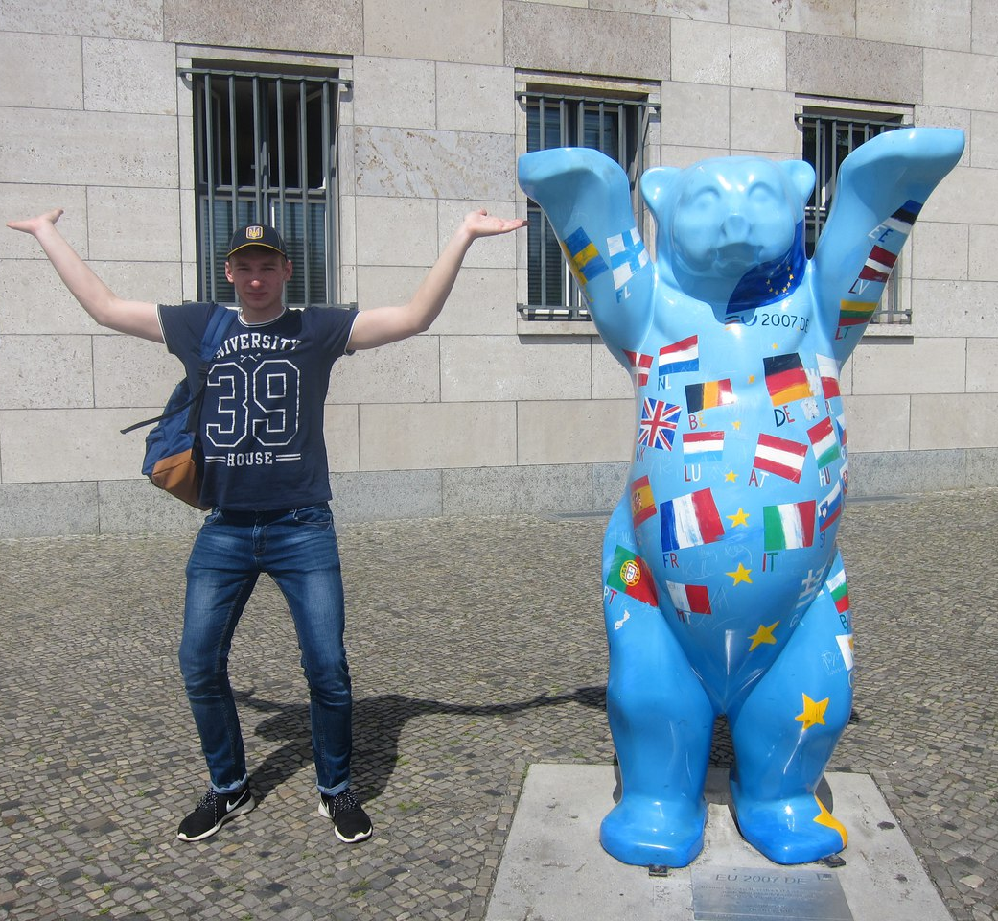
Is there some credibility? ☺
Mykola Kravets
5 international events
and conferences
2 Erasmus+ projects
1 scholarship
1 semester abroad
10+ applications sent

Slide 3
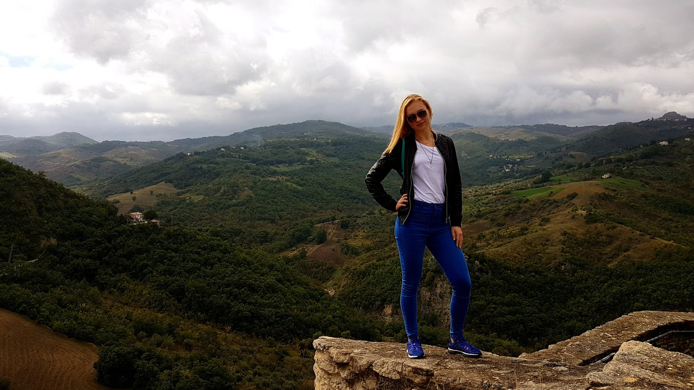
Charming motivation☺
Mariia Bilenka
2 Youth Exchanges: Croatia (6 participants – 70 applicants),
Italy (5 participants – 100 applicants)

Slide 4
Our remote “inspirator” ☺
Maryna Bykova
EVS Volunteer in Weimar, Germany currently
10+ international youth exchange programmes

Slide 5
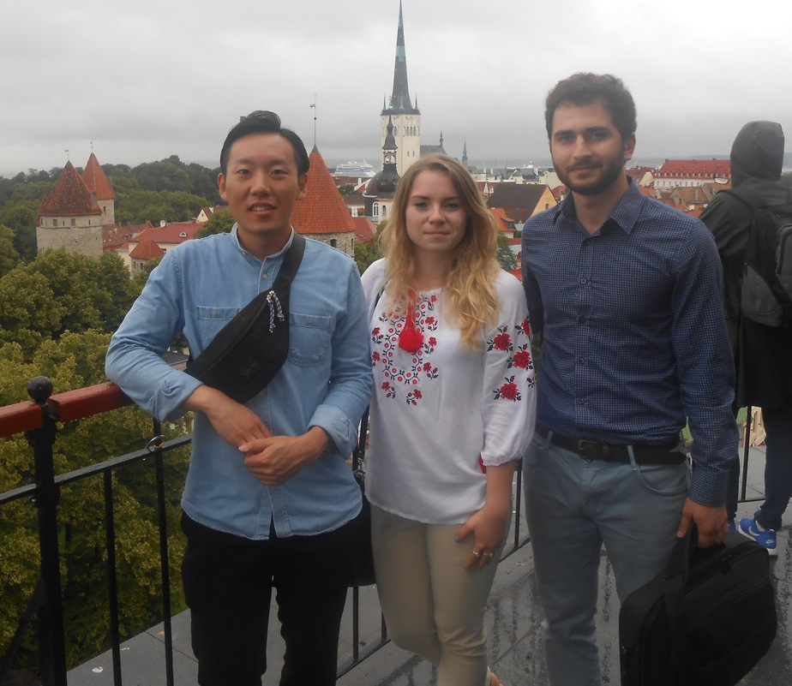
Guess which of them? ☺
Anna Harus
2 international summer universities
2 scholarships
> 5 international and Ukrainian youth forums
> 15 applications sent ☺

Slide 6
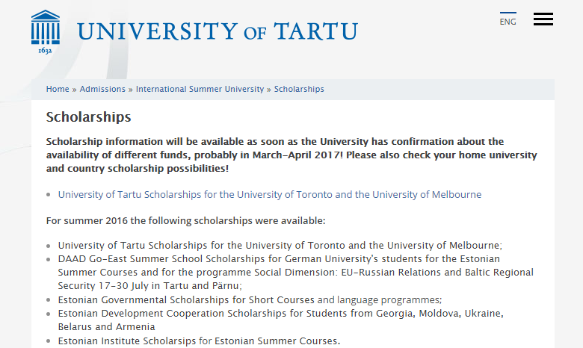
Estonian Development Cooperation Scholarships for Students from Georgia, Moldova, Ukraine, Belarus and Armenia
July
DEADLINE: 10 April!
http://www.ut.ee/en/admissions/scholarships-summer-2016

Slide 7
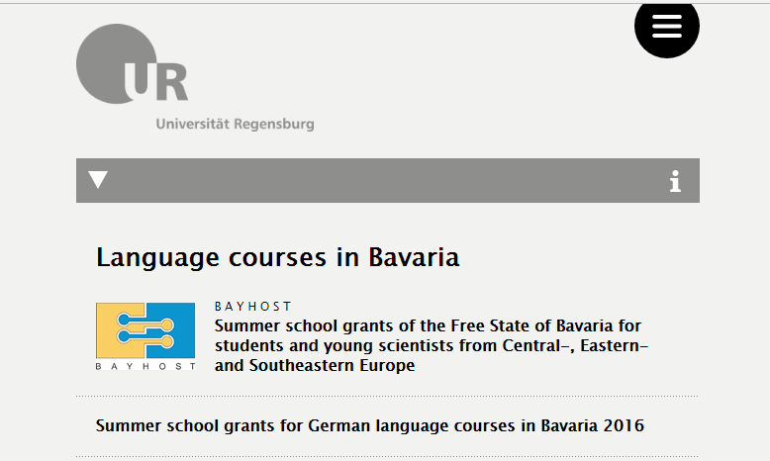
BAYHOST Scholarships
August
DEADLINE: 04 April, per post!
http://www.uni-r.de/bayhost/english/scholarships/language-courses-in-bavaria/index.html

Slide 8
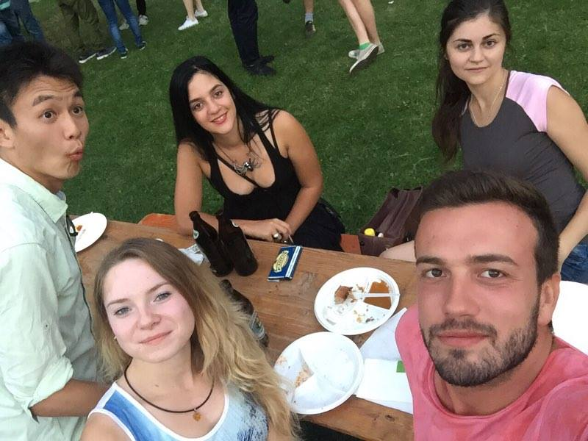
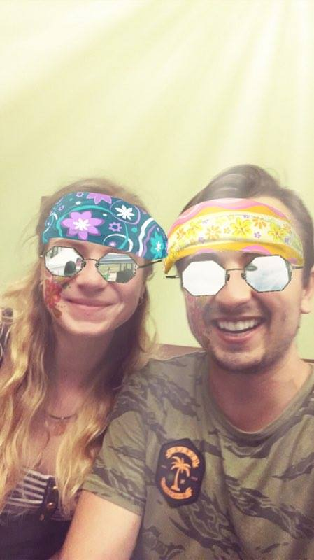
International exchange… What for?
1. Lots of fun, socializing and hanging out

Slide 9
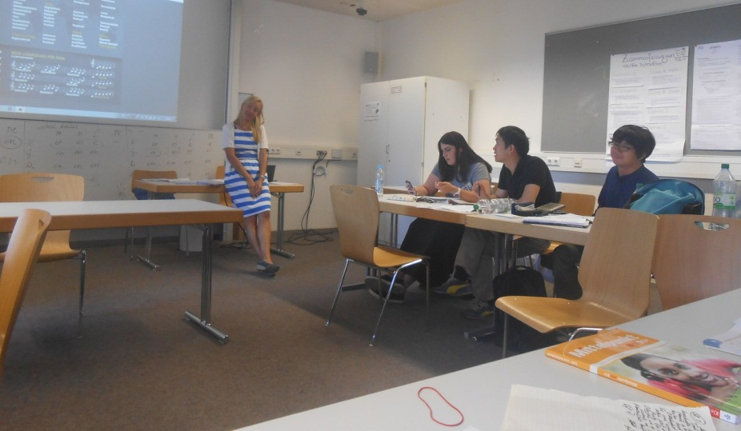
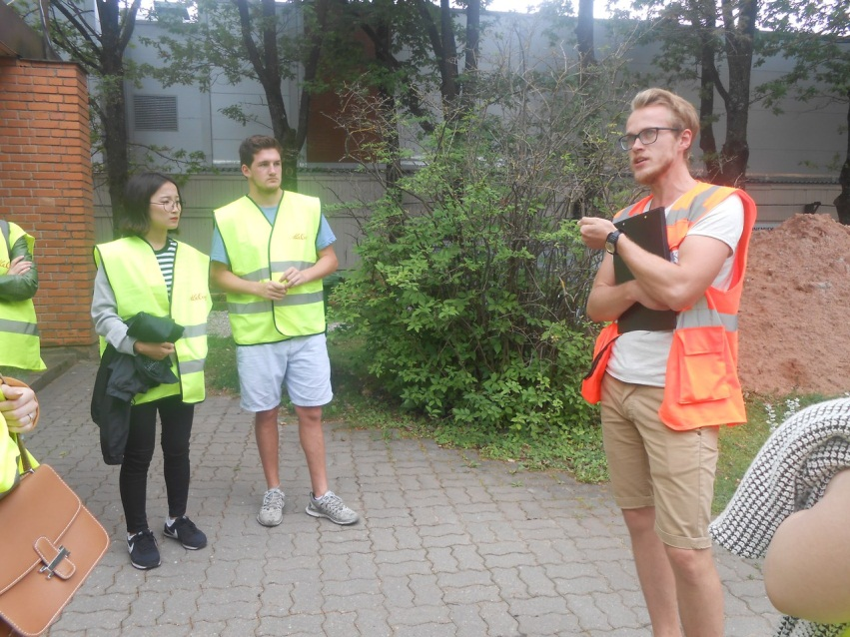
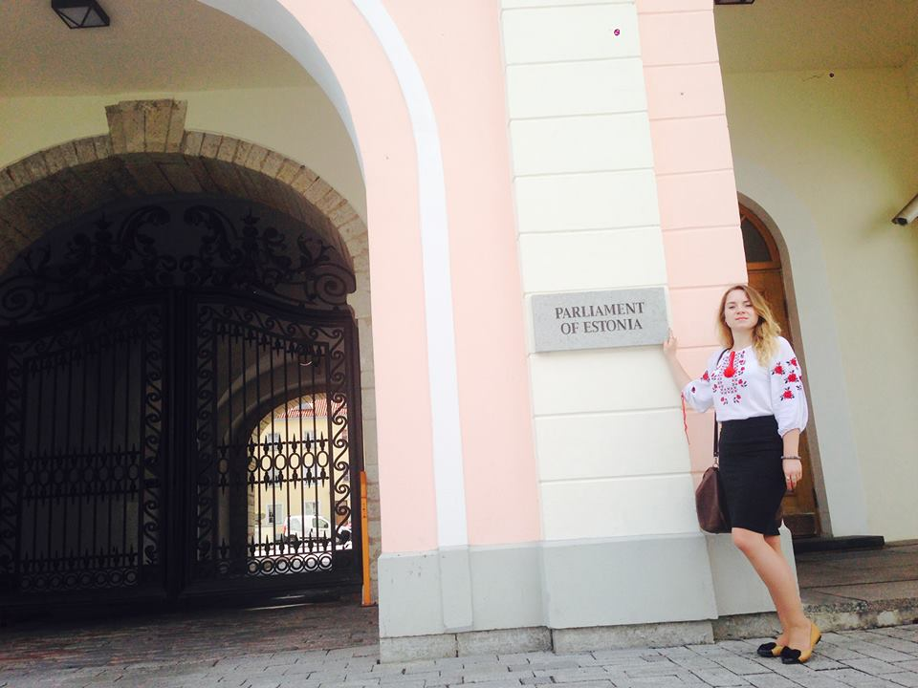
International exchange… What for?
2. New useful, professional knowledge

Slide 10
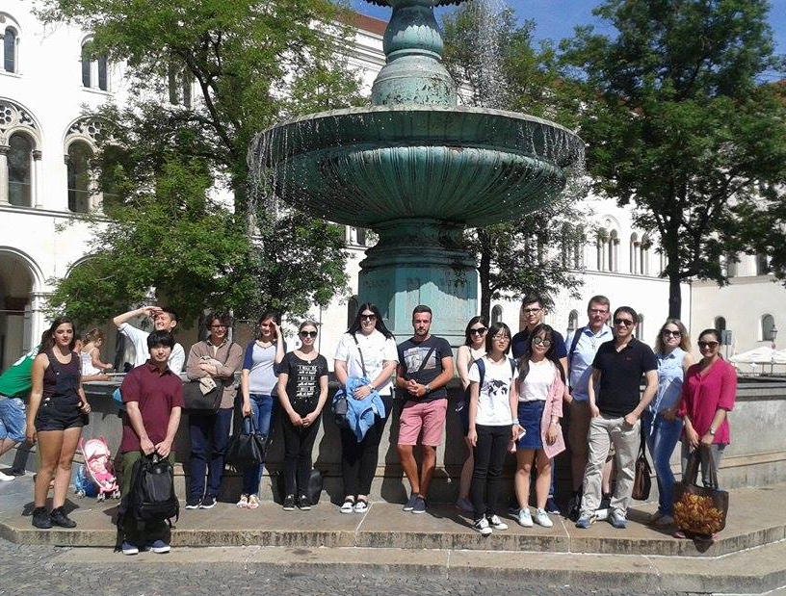
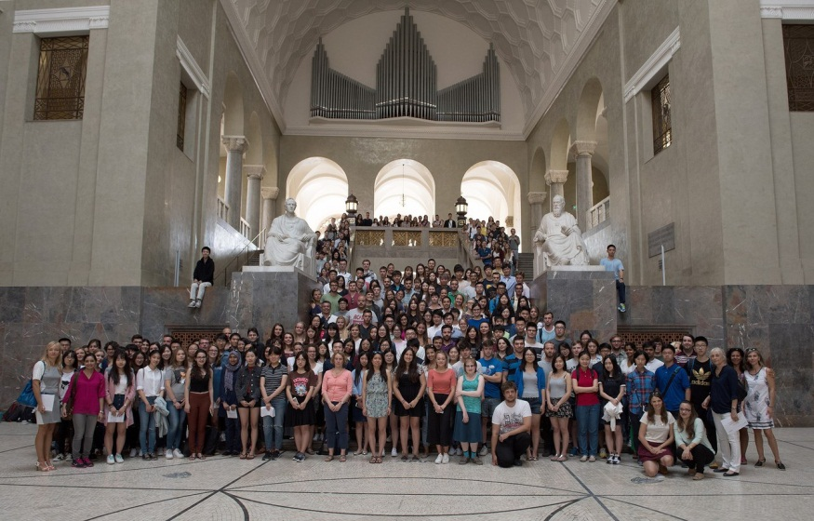
International exchange… What for?
3. Several-week non-stop English practice with awesome young people from > 50 countries

Slide 11
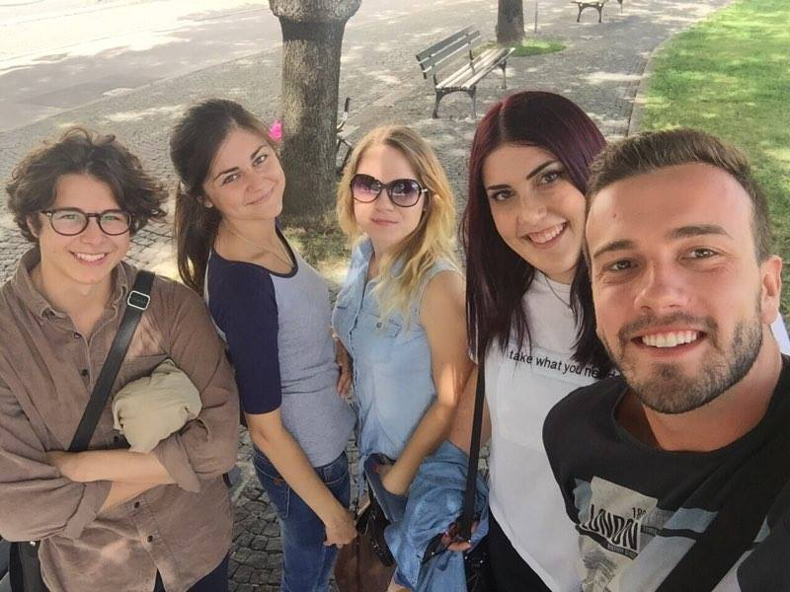
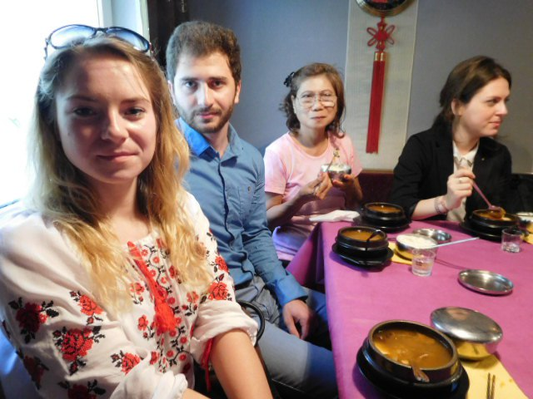
International exchange… What for?
4. Make good friends from all over the world… and maybe more then friends...

Slide 12
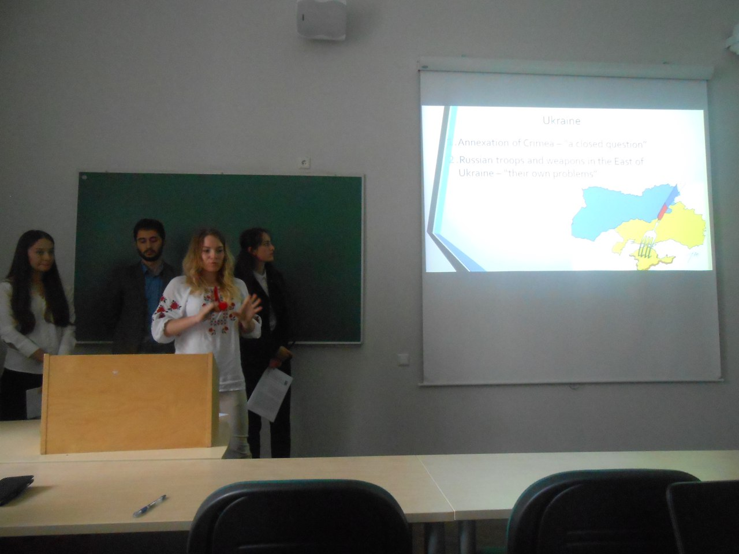
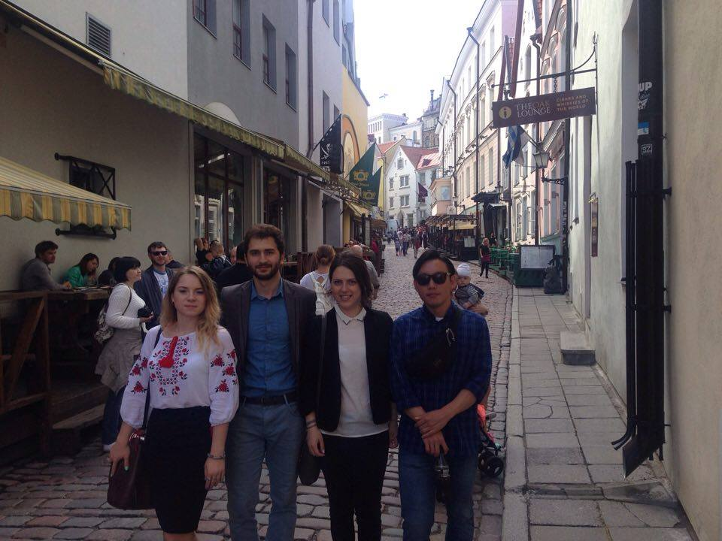
International exchange… What for?
5. Increase awareness of Ukraine in the world

Slide 13
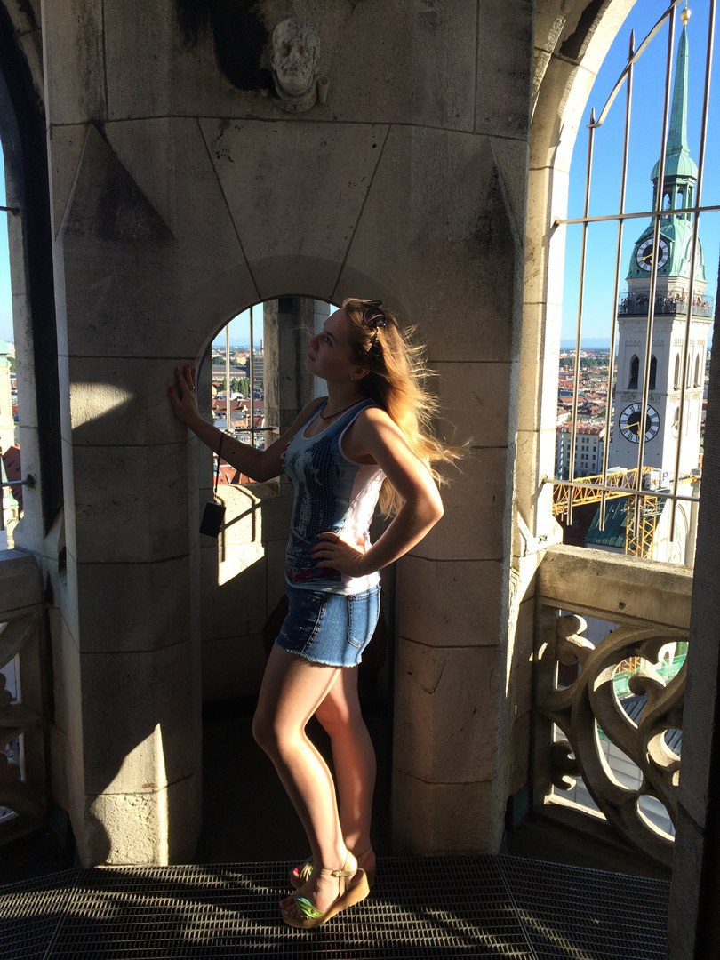
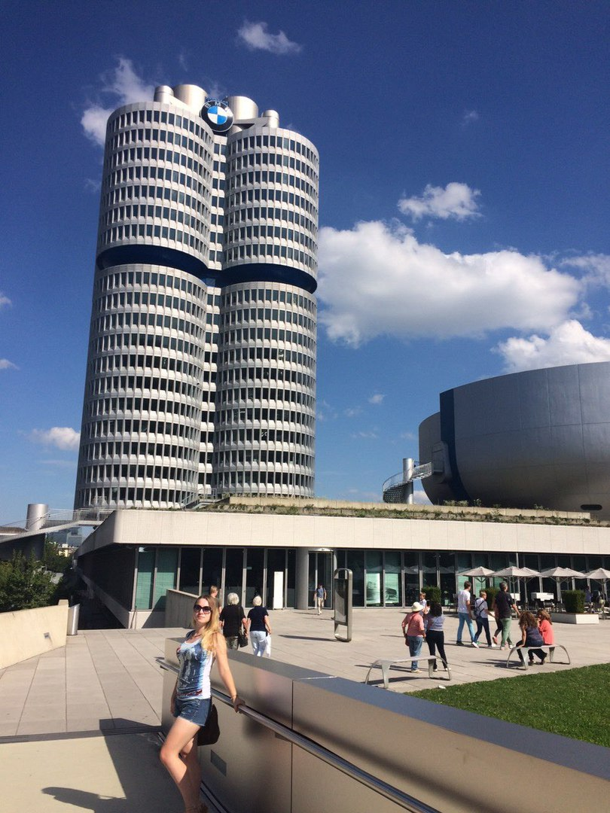
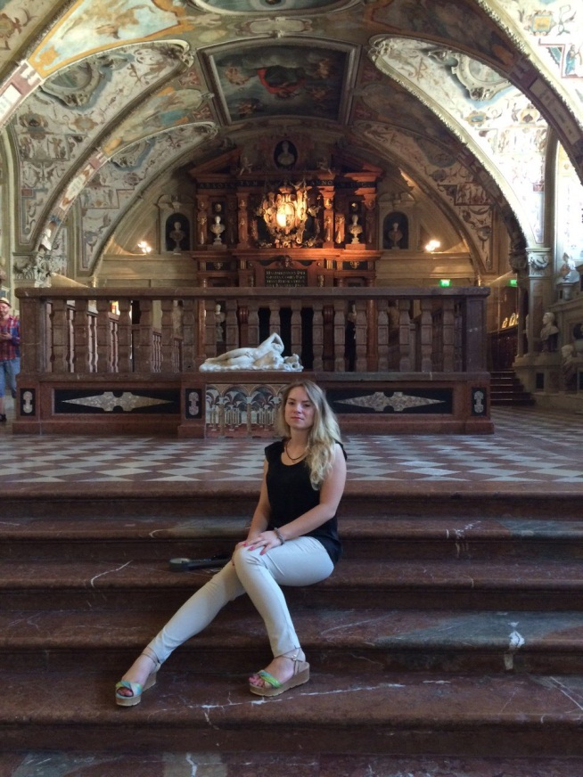
International exchange… What for?
6. Travel and endless sightseeing

Slide 14
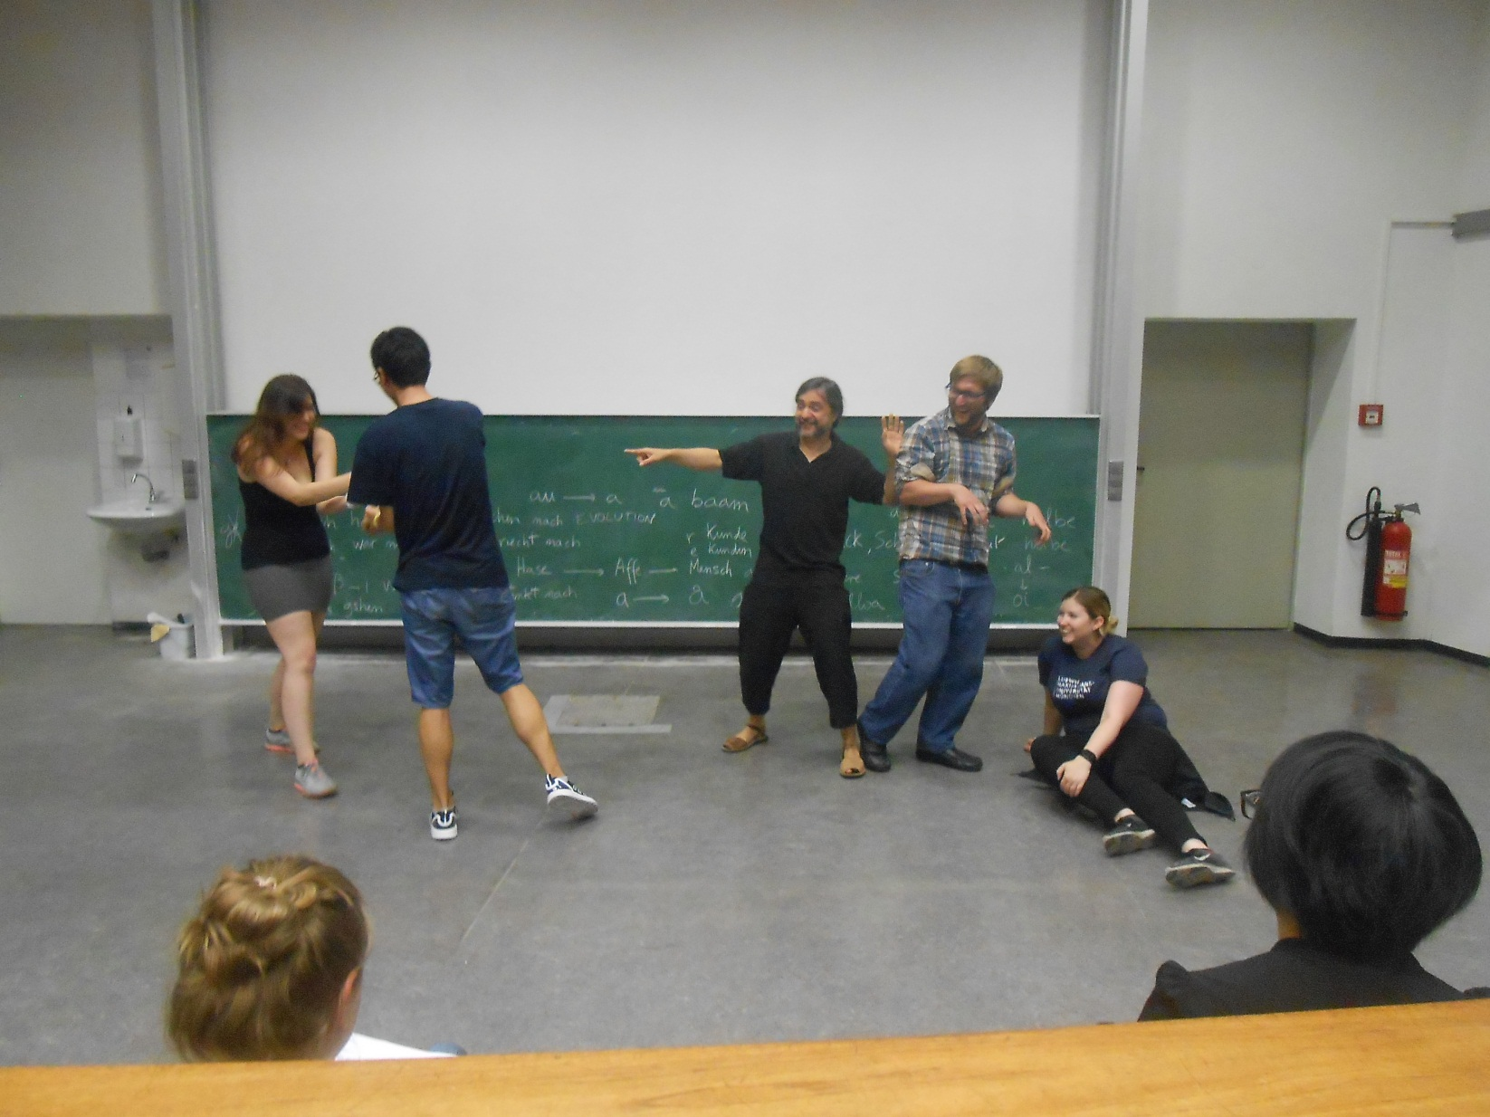
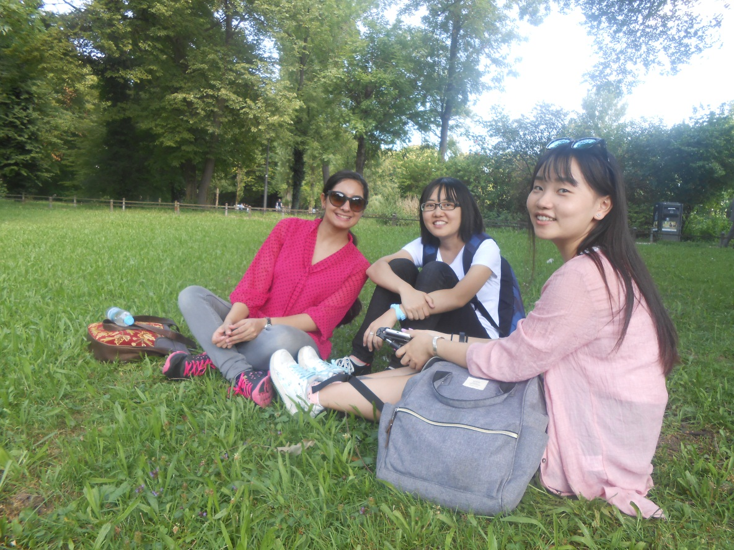
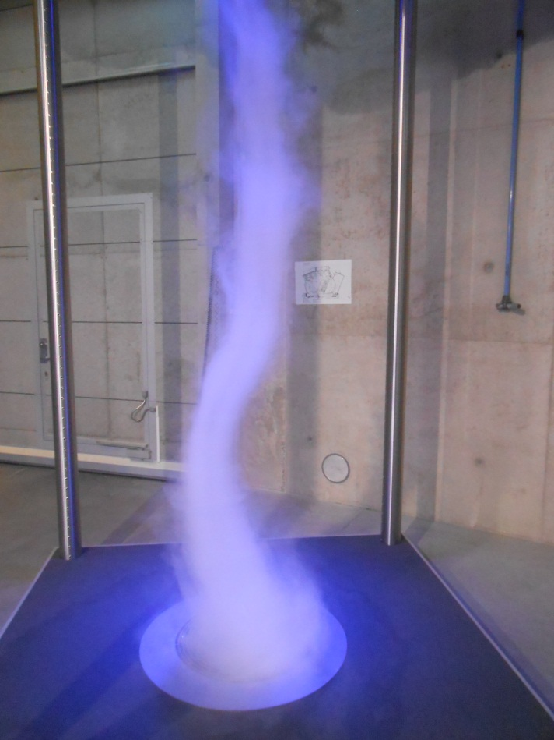
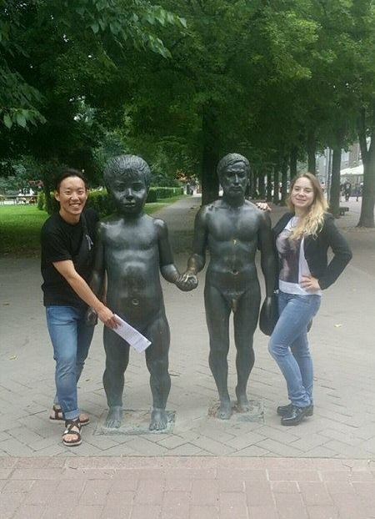
International exchange… What for?
7. Expand your horizons and break stereotypes

Slide 15
YES! I want it!

Slide 16
What do I have to do now?
Subscribe to the websites and groups with numerous opportunities

Slide 17
What do I have to do now?

Slide 18
What do I have to do now?

Slide 19
What do I have to do now?
http://www.youthop.com/ -
http://www.edu-active.com/ -
http://www.mladiinfo.eu/
http://platfor.ma/mozhlivosti/postosvita/
http://unistudy.org.ua/
https://biggggidea.com/opportunities/3169/
http://www.internationalscholarships.com/
http://www.studyabroad.com/
http://www.daad.org.ua/ukr/stipendien.htm -
http://eastchance.com/index.asp
http://grantist.com
http://scholarshipcare.blogspot.com
http://www.afterstudy.com.ua/?p=4513

Slide 20
Types of programmes (with scholarships or expenses cover)
ERASMUS+ grants for NGOs and their Youth Exchanges
International Students Festivals
Up-to-7-day Youth Forums
Internships (foreign companies, international organisations, EVS)
Summer Schools and International Summer Universities organized by Universities and supported by National Ministries, Parliaments or Foundations (with or without ECTS credits)
Exchange Semester abroad (bilateral uni. Agreements)
Bachelor’s / Master’s Programmes
PhD Research Programmes
…endless list…

Slide 21
Germany
https://www.boell.de/en/scholarships/scholarships.html
http://www.daad.org.ua
http://www.deutschlandstipendium.de
http://www.mystipendium.de/
http://www.kas.de/wf/en/71.14301/
http://www.rosalux.de/english/foundation.html Rosa-Luxembourg-Stiftung
https://www.humboldt-foundation.de/web/programme-nach.. Alexander-von-Humboldt-Stiftung
http://www.copernicus-stipendium.de
https://www.fes.de/de/ – Friedrich-Ebert-Stiftung
https://www.study-in.de/en/plan-your-studies/find-pro..
http://abfby.org/deutschlandstipendium-stipendiya-dly..

Slide 22
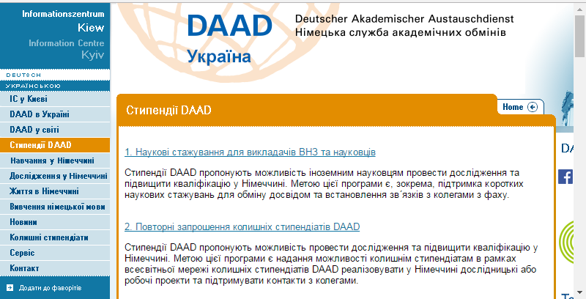
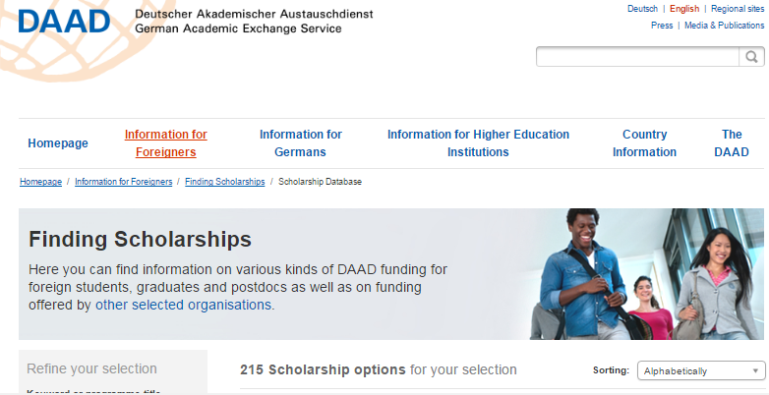
Germany

Slide 23
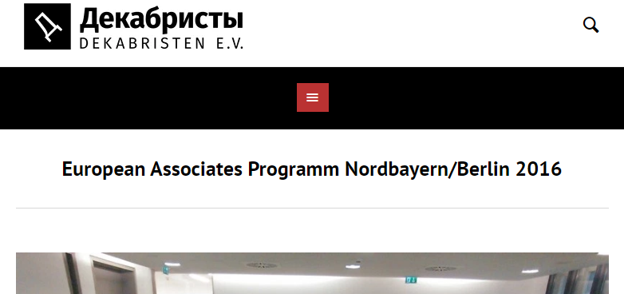
http://dekabristen.org/project/european_associates_programm_nordbayern_berlin/

Slide 24
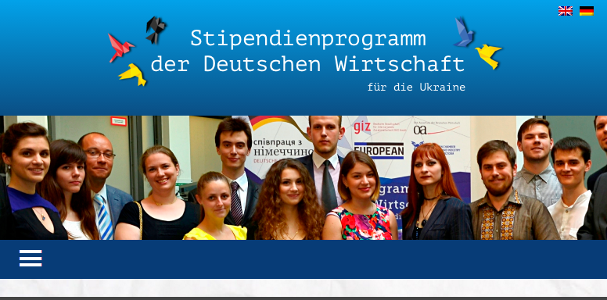
http://stipendienprogramm-ukraine.de/en/applicants/call-for-application-and-procedure/ -

Slide 25
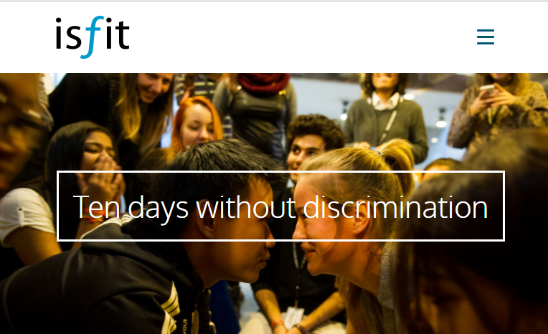
International Students Festival in Trondheim
Every 2 years (February 2017)
DEADLINE: 30 September!
https://www.isfit.org/

Slide 26
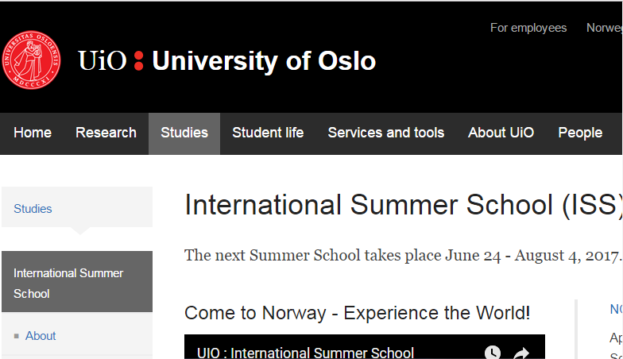
University of Oslo International Summer School
July-August
DEADLINE: 30 January!
http://www.uio.no/english/studies/summerschool/admission/

Slide 27
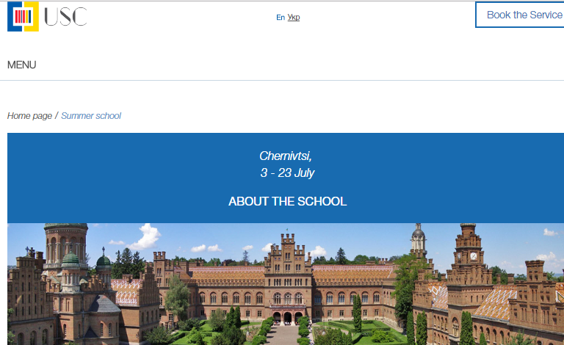
Ukrainian-Scandinavian Summer School
July
DEADLINE: 10 April!
http://ukr-scandinavian.org/summer-school/about-the-school/

Slide 28
Study Tours to Poland
Autumn or Spring
DEADLINE: 10 July or 10 January!
http://www.studytours.pl/index.php?lang=uk

Slide 29
Traineeships in Europe
http://www.consilium.europa.eu/en/general-secretariat/jobs/traineeships/ - Traineeships at the General Secretariat, European Council (4th year of study) – June-August deadline
http://ec.europa.eu/stages/about/advantages_en - Traineeships in the European Commission (4th year of study) – June-August deadline
WTO, OSCE, EBRR – Bachelor’s Degree
FAO

Slide 30
Typical requirements
Age limit 18(20) - 25(30)
University degree(s)
Be a leader in community, active social engagement in NGO (1 year)
Follow-up Report / Dissemination of Knowledge
Good academic achievements
Work experience
Scientific research plan

Slide 31
Typical documents
Application Form + a set of documents via e-mail/post
Motivation Letter or Essay
Copy of Foreign Passport (+ Schengen Visa)
Educational programme: Academic Transcript, “Certificate” Paper from the Dean’s Office
Portfolio with your Certificates and Diplomas
Language Certificate (or Chair’s confirmation)
1-3 Reference Letters

Slide 32
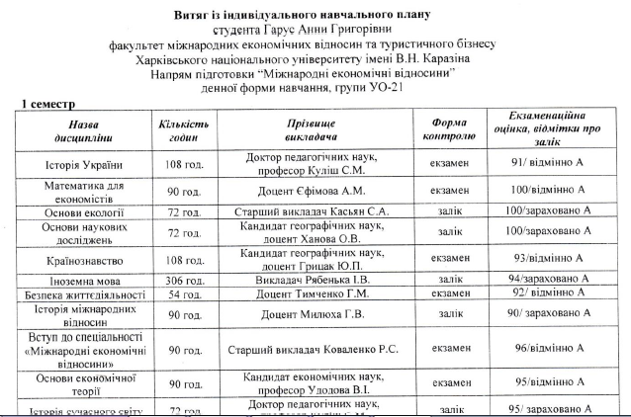
What do I have to do now?
2. Always have your Academic Transcript and its English translation
3. Prepare your CV
https://europass.cedefop.europa.eu/editors/en/cv/compose

Slide 33
Some CV tips
Live for pleasure and commitment, work and study for CV!
Try to get certificates with everything you do
Social engagement is very important
Create a normal e-mail address
Max. 2 pages
Photo of an open-minded person
Reverse chronological order
Hobbys and extra photos are needless
Europass or individual?
Tabular, well-structured, visualized!
Have at least 2 people who can give you a reference
Look at it once again and cut it twice!

Slide 34
Some CV tips

Slide 35
What do I have to do now?
4. Choose the programme and start writing your motivation!

Slide 36
Some Motivation tips
Clearly arranged:
Dear Sir or Madam,
Para 1. I am writing… (programme)
Para 2. Tell about yourself. (You have clear objectives. Your background suits perfectly for the programme)
Para 3-5. Why are you interested in the programme (3 reasons)? How will it help you in the future? Why should YOU be chosen? Which contribution can YOU make to the programme?
Closing Para. Be creative and rememberable. Say something special and promise an action.
Polite closing remarks.
Yours faithfully, …

Slide 37
Some Motivation tips
Never exceed words limit more than by 50 words.
1-2 A4 pages!
Good English and easy-to-read text, sound positively!
No common phrases and well-known facts !
Every thought should be understood, every idea delivered and clearly stated
Your enormous desire should transform into persuasive confidence about you being a best candidate
Don’t look naughty, miserable or poor
Ideal motivation formula: your previous experience + your current activities + your plans for the future = you are the One for the programme
Uniqueness and creativity are your ALL!
Do not repeat yourself. Each sentence and every word should state something new!

Slide 38
What do I have to do now?
5. DEADLINE: look out! Until it comes, improve your motivation to make it perfect!

Slide 39
What do I have to do now?
6. DEADLINE: meet it, send off everything, say thanks to God and forget about your application!

Slide 40
What do I have to do now?
7. Got the acceptance letter to your e-mail, shout and jump with joy and apply for your visa!

Slide 41
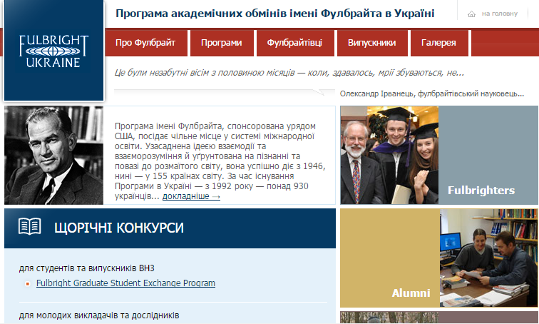
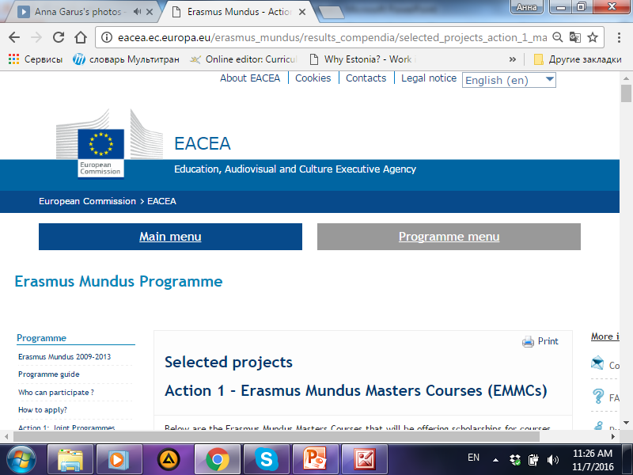
Something more serious

Slide 42
What’s the closest?
https://2017.iswi.org/
http://www.idy-ttokyo-forum.com/apply/
http://www.internationalcareersfestival.org/
https://peacerevolution.net/docs/en/bridge-fellowship
http://www.blindapplying.com/sign-up
http://www.russia2017.com/
http://www.mladiinfo.eu/2016/10/14/summer-institute-leadership-international-cooperation-california/

Slide 43
Closing remarks
1 week – 3 months for documents, not less than a week for Motivation
Ask for advice successful applicants and collect them
Sometimes you cannot do without work experience
Distinguish yourself from others!
There’s always smth to strive for!
YOU have to want it, search for the opportunities and find the way!
Sometimes you are simply too young ☺
Never give up and keep on applying even when you have got a Harvard scholarship ☺

Slide 44
#Prepared by Anna Harus

