Slide 1
The Foreign Policy of the European Union
Jean Monnet Module

Slide 2
The Foreign Policy of the European Union
The Actors and Procedures of EU Foreign Policy

Slide 3
The Actors and Procedures of EU Foreign Policy
Understanding the Foreign Policy of the EU
Institutional Framework (The European Council; The Council; The Commission;

Slide 4
The Actors and Procedures of EU Foreign Policy
the High Representative\Vice-President; the EU’s Diplomatic Service (European External Action Service); the European Parliament; the European Court of Justice)
3. The policy-making process

Slide 5
Why to study the EU FP?
EU is an influential actor of international relations
EU is a major economic actor, the world’s largest trading bloc

Slide 6
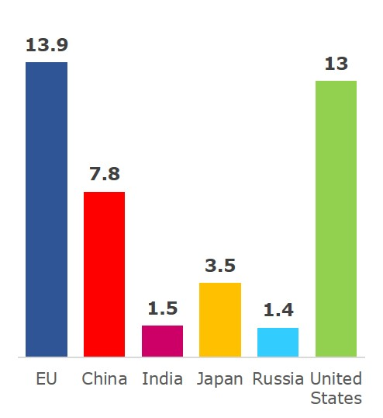
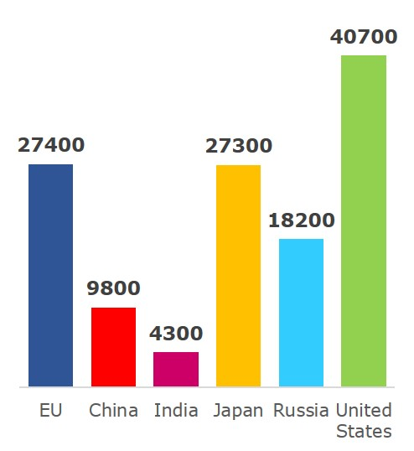
How rich is the EU compared to the rest of the world?
Size of economy:
GDP in trillions of euro (2014)
Wealth per person:
GDP per person (2014)

Slide 7
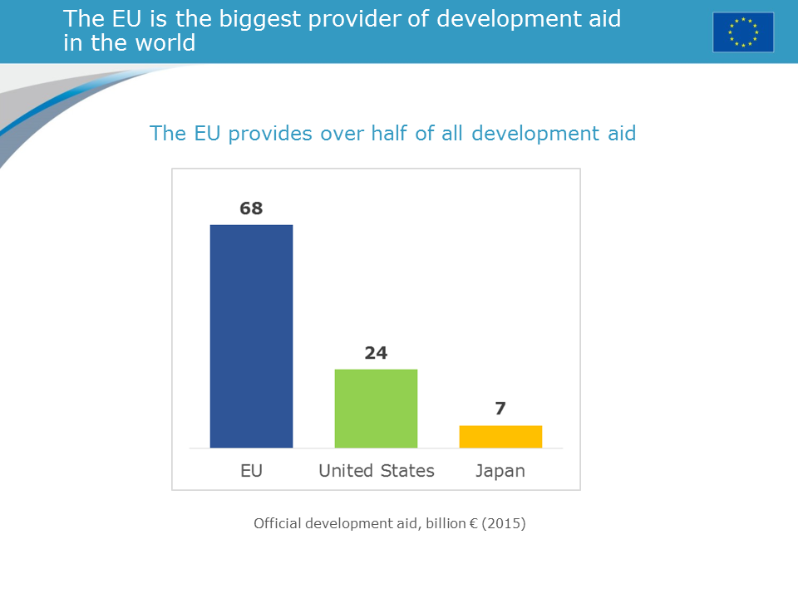
)

Slide 8
Federal States vs Unitary States
FEDERAL STATE
“A federal State is a union of States in which both the federation and the Member States embody the constitutive elements of a State: LEGISLATIVE, EXECUTIVE AND JUDICIAL POWER over territory and citizens. State authority is divided between the federation (…) and the Member States (..), both of which possess certain assigned competences and functions.”
Rudolf, Walter 2011. Federal States. In Max Planck Encyclopedia of Public International Law

Slide 9
Federal States, Unitary States & Confederations
Confederation of States
“A confederation is a governmental entity created by independent sovereign State[s] that join together to perform some governmental functions under common authority (…).A confederation is a stronger form of association than an alliance, but is weaker than a federation. The individual member units retain their status as sovereign States, and are separately recognized as members of the international community.”
Morrison, Fred L. 2007. Confederations of States. In Max Planck Encyclopedia of Public International Law [MPEPIL].

Slide 10
SUPRANATIONAL LEGAL ORDER THE VAN GEND EN LOOS CASE
“The conclusion to be drawn from this is that the Community constitutes a
new legal order of international law for the benefit of which the states have
limited their sovereign rights” (1963)

Slide 11
Understanding the Foreign Policy of the EU
sensu stricto (CFSP; CSDP)
sensu lato (CFSP; CSDP + external actions, external dimensions of internal policies (trade, energy, development, enlargement, HR)

Slide 12
Understanding the Foreign Policy of the EU
EU FP is the area of European policies that is directed at the external environment with the aim of influencing that environment and the behavior of other actors within it, in order to pursue interests, values and goals.

Slide 13
The Changing Context of the EU Foreign Policy
The peace project for Europe
The end of the Cold War, the EU enlargement to the East;
The financial and sovereign debt crises, the European migrants\refugees crises

Slide 14
The (Monnet)-Schuman Declaration 9 May 1950
The peace project for Europe:
"World peace cannot be safeguarded without the making of creative efforts proportionate to the dangers which threaten it."

Slide 15
The (Monnet)-Schuman Declaration 9 May 1950
"Europe will not be made all at once, or according to a single plan. It will be built through concrete achievements which first create a de facto solidarity."

Slide 16
The (Monnet)-Schuman Declaration 9 May 1950
‘The French Gov. proposes that Franco-German production of coal and steel as a whole be placed under a common High Authority, within the framework of an organization open to the participation of the other countries of Europe’.

Slide 17
The (Monnet)-Schuman Declaration 9 May 1950
‘The pooling of coal and steel production should immediately provide for the setting up of common foundations for economic development as a first step in the federation of Europe, and will change the destinies of those regions which have long been devoted to the manufacture of munitions of war, of which they have been the most constant victims.’

Slide 18
The (Monnet)-Schuman Declaration 9 May 1950
‘The solidarity in production thus established will make it plain that any war between France and Germany becomes not merely unthinkable, but materially impossible. The setting up of this powerful productive unit, open to all countries willing to take part and bound ultimately to provide all the member countries with the basic elements of industrial production on the same terms, will lay a true foundation for their economic unification.’

Slide 19
The End of the Cold War The big enlargement: uniting east and west
1989
Fall of Berlin Wall; EU economic help begins to the post-socialist countries: Phare programme
1992
Criteria set for a country to join the EU: • democracy and rule of law; • functioning market economy;• ability to implement EU laws
1998
Formal negotiations on enlargement begin
2002
Copenhagen summit agrees to a big enlargement of 10 new countries
2004
Ten new EU members: Cyprus, Czech Republic, Estonia, Hungary, Latvia, Lithuania, Malta, Poland, Slovakia, Slovenia
2007
Bulgaria and Romania
2013
Croatia joins on 1 July

Slide 20
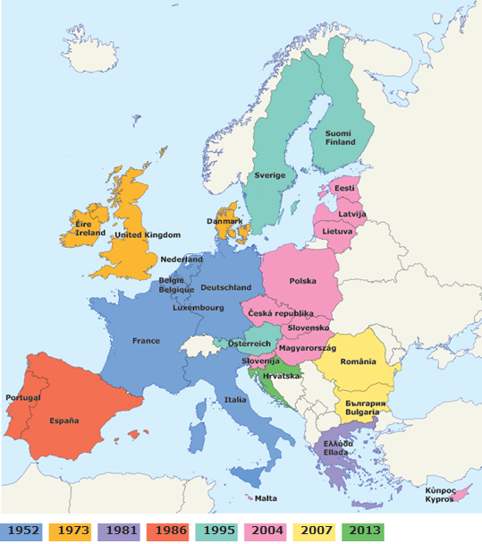
Enlargement: from six to 28 countries

Slide 21
Candidate countries and potential candidates
Country | Area (x 1000 km²) | Population (millions) | Wealth (gross domestic product per person)
Bosnia and Herzegovina | 51 | 3.8 | 7 800
Montenegro | 14 | 0.6 | 10 600
Kosovo under UN Security Resolution 1244 | 11 | 1.8 | :
The former Yugoslav Republic of Macedonia | 25 | 2.1 | 10 000
Albania | 28 | 2.9 | 7 800
Serbia | 77 | 7.2 | 9 600
Turkey | 783 | 77.7 | 14 400
The 28 EU countries together | 4 272 | 508.2 | 27 400

Slide 22
The European migrants\refugees crises
Tensions inside the MS
Tensions between the MS

Slide 23
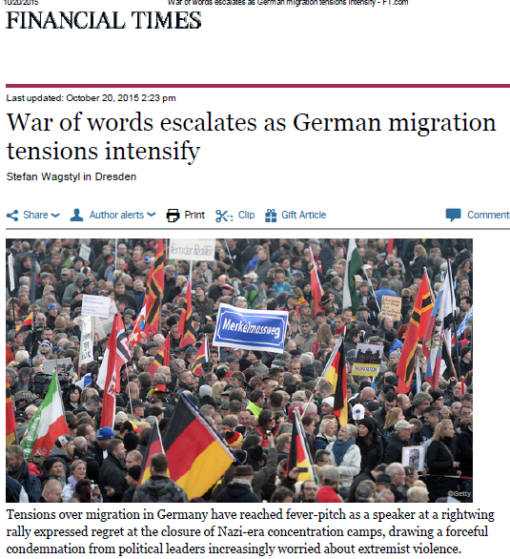
Political tensions inside the member states

Slide 24
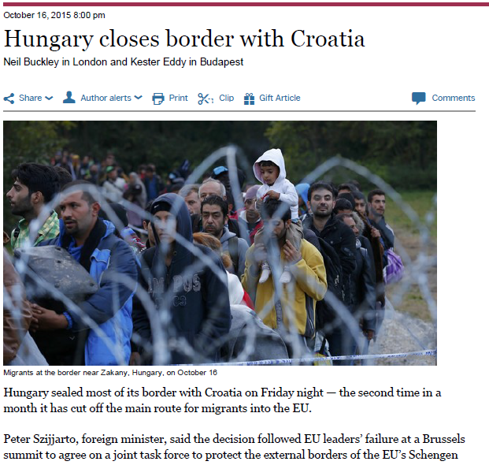
Political tensions between the member states

Slide 25
The Euro zone crisis

Slide 26
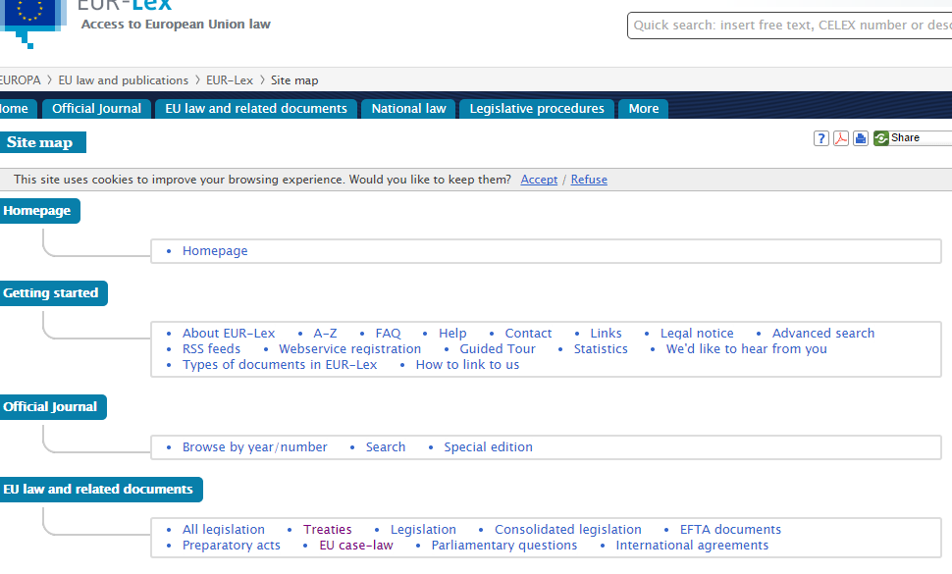
Sources to Follow http://eur-lex.europa.eu/

Slide 27
http://eur-lex.europa.eu/

Slide 29
Understanding the Foreign Policy of the EU
multifaceted;
multi-method;
multi-level

Slide 30
Understanding the Foreign Policy of the EU
Multifaceted foreign policy but not all-encompassing

Slide 31
Understanding the Foreign Policy of the EU
… competences not conferred upon the Union in the Treaties remain with the Member States. (Art.4)

Slide 32
Understanding the Foreign Policy of the EU
The limits of Union competences are governed by the principle of conferral. The use of Union competences is governed by the principles of subsidiarity and proportionality.

Slide 33
Understanding the Foreign Policy of the EU
Under the principle of conferral, the Union shall act only within the limits of the competences conferred upon it by the Member States in the Treaties to attain the objectives set out therein. Competences not conferred upon the Union in the Treaties remain with the Member States.
Under the principle of subsidiarity, in areas which do not fall within its exclusive competence, the Union shall act only if and in so far as the objectives of the proposed action cannot be sufficiently achieved by the Member States, either at central level or at regional and local level, but can rather, by reason of the scale or effects of the proposed action, be better achieved at Union level.

Slide 34
Understanding the Foreign Policy of the EU
The EU’s competence varies depending on the foreign policy dimension at stake.
MS retain control over the FP

Slide 35
Understanding the Foreign Policy of the EU
Multi-method foreign policy:
treaty settings (the Treaty on EU and the Treaty on the Functioning of the EU)
Intergovernmental and community methods

Slide 36
Treaty on EU
Title I Common provisions
Title II Provisions on democratic principles
Title III Provisions on institutions
Title IV Provisions on enhanced cooperation
Title V General provisions on the Unions external action and specific provisions on the Common Foreign and Security Policy (CFSP)
Chapter 1; Chapter 2 (Section 1 Common provisions Section 2 Provisions on the Common security and defence policy)
Title VI Final provisions

Slide 37
Treaty on the Functioning of the EU
Part one Principles
Part two Non discrimination and citizenship of the Union
Part three Union policies and internal actions
Title I The internal market
Title III Agriculture and fisheries
Title V Area of freedom, security and justice
Title VIII Economic and monitory policy

Slide 38
Treaty on the Functioning of the EU
Title XIX Research and technological development and space
Title XX Environment
Title XXI Energy
Part four Association of the oversee countries and territories
Part five The Union’s external actions
Title I General provisions on the Union’s external actions
Title II Common commercial policy
Title III Cooperation with third
countries and humanitarian aid

Slide 39
Treaty on the Functioning of the EU
Title IV Restrictive measures
Title V International agreements
Title VI The Union’s relations with international organizations
Title VII Solidarity clause
Part six Institutional and financial provisions
Part seven General and final provisions
Declarations

Slide 40
Treaty on the Functioning of the EU
Declarations
13. Declaration concerning the common foreign and security policy
14. Declaration concerning the common foreign and security policy

Slide 41
Understanding the Foreign Policy of the EU
Multi-level foreign policy
interaction between the national and EU levels

Slide 42
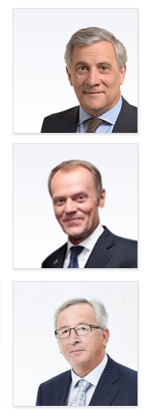
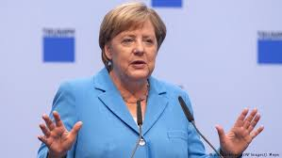
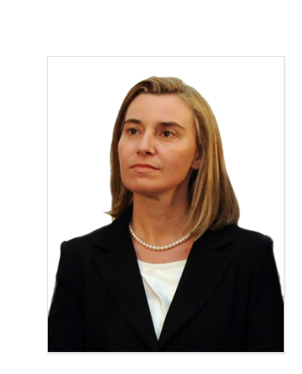
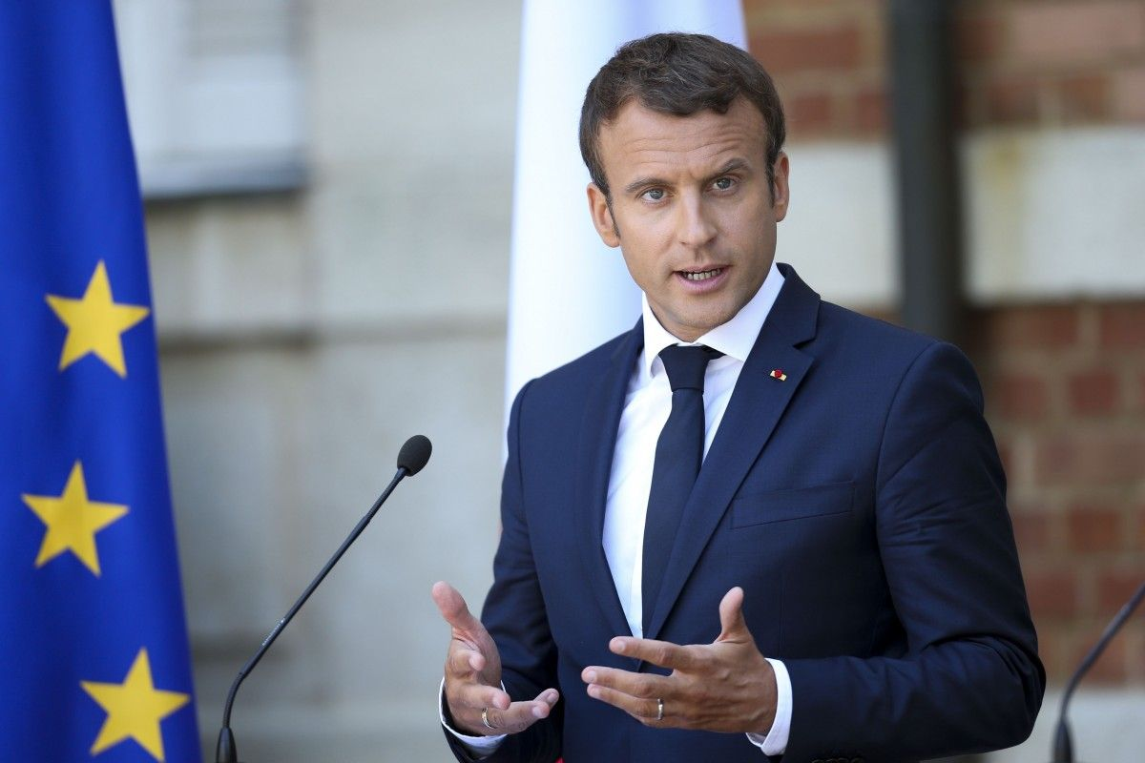
Whom should I call to speak to Europe?!

Slide 43
Institutional Framework of the EU Foreign Policy

Slide 44
Institutional Framework of the EU Foreign Policy

Slide 45
Institutional Framework of the EU Foreign Policy
European Council (summit)
European Parliament
Council of Ministers
(The Council)
European Commission
Court of Justice
Court of Auditors
Economic and Social Committee
Committee of the Regions
European Investment Bank
Agencies
European Central Bank

Slide 46
Institutional Framework of the EU Foreign Policy
1. The Union shall have an institutional framework which shall aim to promote its values, advance its objectives, serve its interests, those of its citizens and those of the Member States, and ensure the consistency, effectiveness and continuity of its policies and actions.
The Union's institutions shall be:
— the European Parliament,
— the European Council,
— the Council,
— the European Commission,
— the Court of Justice of the European Union,
— the European Central Bank,
— the Court of Auditors.
2. Each institution shall act within the limits of the powers conferred on it in the Treaties, and in conformity with the procedures, conditions and objectives set out in them. The institutions shall practice mutual sincere cooperation.
(Art.13 TEU)

Slide 47
Principle and Values of the EU Foreign Policy
The Union is founded on the values of respect for human dignity, freedom, democracy, equality, the rule of law and respect for human rights, including the rights of persons belonging to minorities. These values are common to the Member States in a society in which pluralism, non-discrimination, tolerance, justice, solidarity and equality between women and men prevail.
(Art.2)
The Union's aim is to promote peace, its values and the well-being of its peoples.
The Union shall offer its citizens an area of freedom, security and justice without internal frontiers, in which the free movement of persons is ensured in conjunction with appropriate measures with respect to external border controls, asylum, immigration and the prevention and combating of crime.
(Art.3)

Slide 48
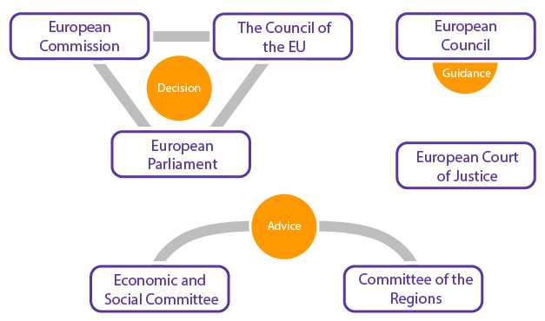
Institutional Framework of the EU Foreign Policy

Slide 49
Institutional Framework of the EU Foreign Policy
The functioning of the Union shall be founded on representative democracy.
Citizens are directly represented at Union level in the European Parliament.
Member States are represented in the European Council by their Heads of State or Government and in the Council by their governments, themselves democratically accountable either to their national Parliaments, or to their citizens.
Every citizen shall have the right to participate in the democratic life of the Union. Decisions shall be taken as openly and as closely as possible to the citizen.
(Art 10 of TEU)

Slide 50
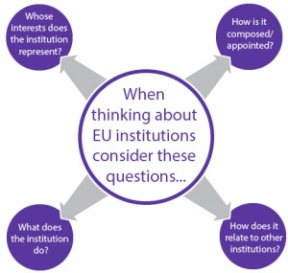

Slide 51
Institutional Framework of the EU Foreign Policy

Slide 52
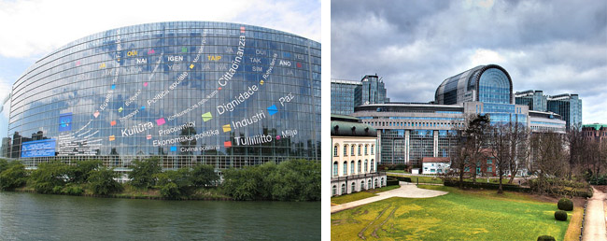
The European Parliament
Competition with Major Powers: the USA, Russia, China
For historical reasons, up until today, the plenary sessions of the European Parliament are held in Strasbourg, while the parliamentary committees and the administrative secretariat are based in Brussels.

Slide 53
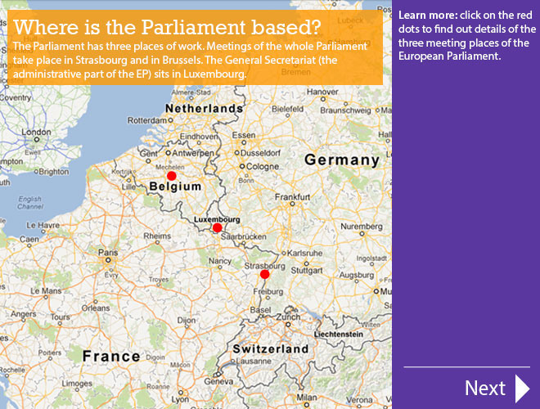
The European Parliament
Competition with Major Powers: the USA, Russia, China

Slide 54
The European Parliament
Competition with Major Powers: the USA, Russia, China

Slide 55
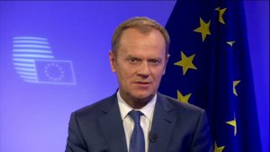
The European Council
Competition with Major Powers: the USA, Russia, China
The European Council is a regular meeting of the heads of state and government of the EU member states.

Slide 56
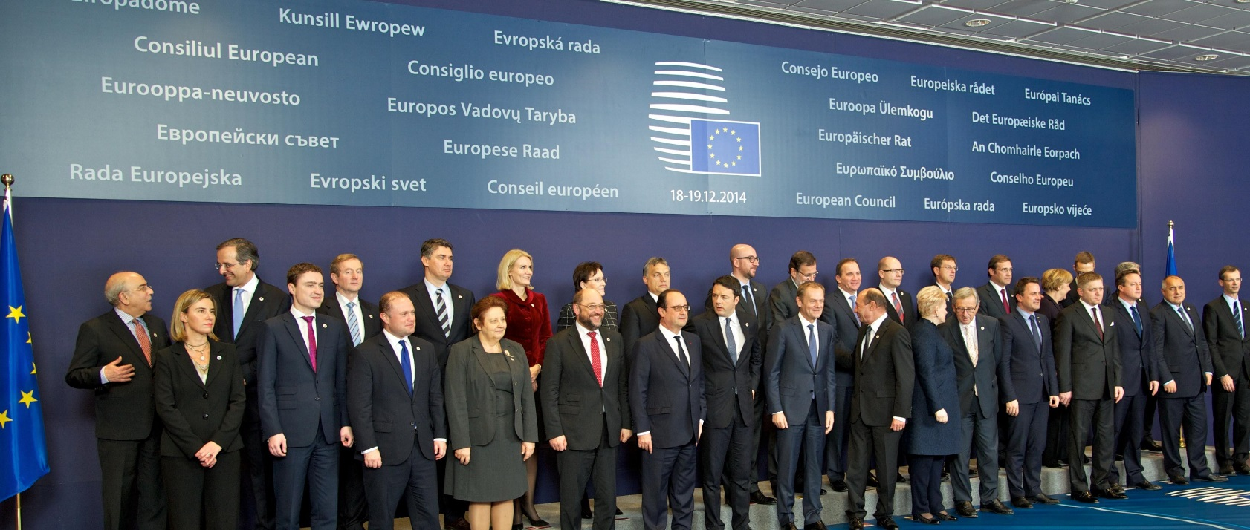
The European Council
Summit of heads of state and government of all EU countries
Held at least 4 times a year
Sets the overall guidelines for EU policies
President: Donald Tusk

Slide 57
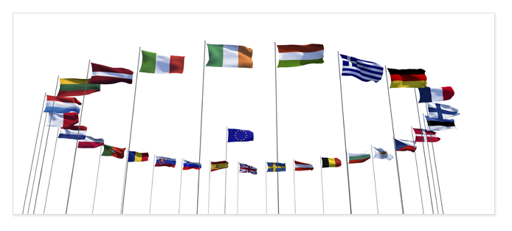
Council of Ministers – voice of the Member States
One minister from each EU country
Presidency: rotates every six months
Decides EU laws and budget together with Parliament
Manages the common foreign and security policy

Slide 58
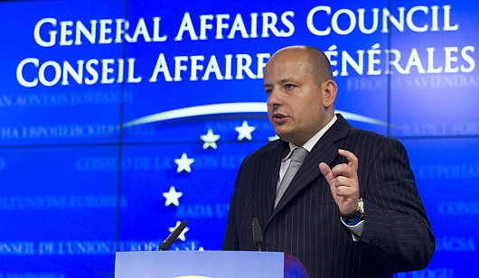
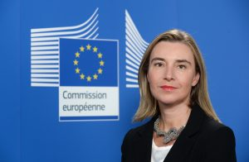
The Council
Competition with Major Powers: the USA, Russia, China
Economic and Financial Affairs (ECOFIN)
Justice and Home Affairs
Employment and Social Policy Affairs
Competitiveness (internal market)
Transport, Telecommunication, Energy
Environment
Education, Youth, Culture and Sport
Agriculture and Fisheries

Slide 59
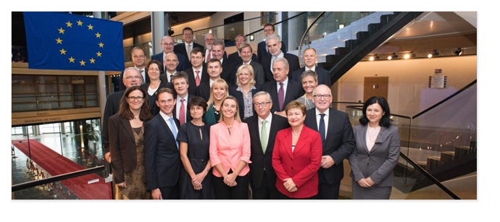
The European Commission
The European Commission – promoting the common interest
28 independent members, one from each EU country
Proposes new legislation
Executive organ
Guardian of the treaties
Represents the EU on the international stage

Slide 60
A high representative for foreign affairs and security
Federica Mogherini
Double role:
chairs meetings of the Foreign Affairs Council
Vice-President of the European Commission
Manages the common foreign affairs and security policy
Head of the European External Action Service

Slide 61
The EU Foreign Policy
Competition with Major Powers: the USA, Russia, China
Events
• round table ‘European Diplomacy in the twenty first century’ (December, 2018, 2019, 2020)
• conference ‘EU Foreign Policy towards Neighbourhood’ (April, 2019, 2020, 2021)
http://hum.port.ac.uk/europeanstudieshub/learning/module-1-understanding-eu-institutions/

Slide 62
The Foreign Policy of the European Union
Thank you for your attention!

